Slide 1
DEMO IV
ZOLTÁN NÉMETH

Slide 2
BLINKING LEDs

Slide 3
MERGED ARRAY
1. array:
0 2 4 6 8 10 12 14 16 18
2. array:
1 3 5 7 9 11 13 15 17 19
Merged array:
0 2 4 6 8 10 12 14 16 18 1 3 5 7 9 11 13 15 17 19

Slide 4
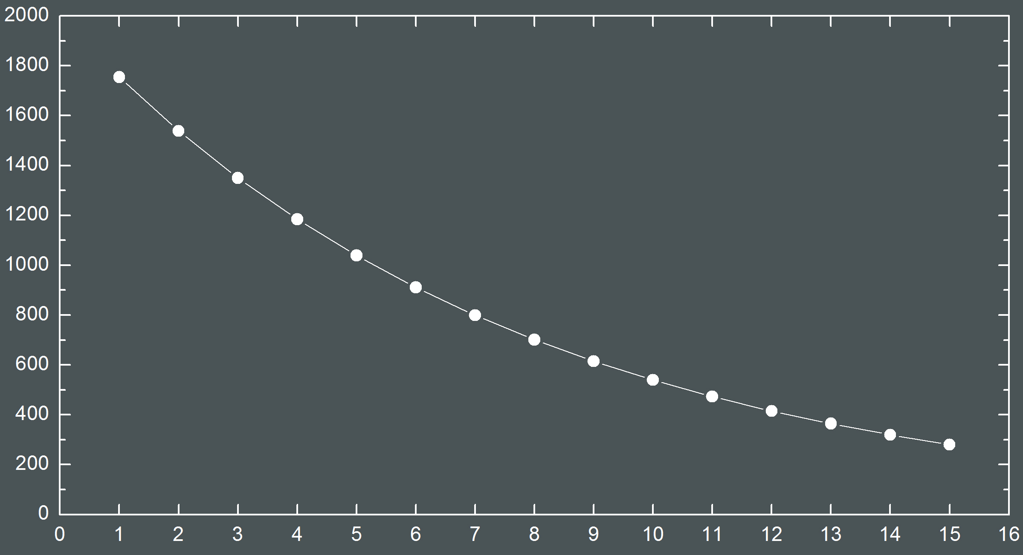

Slide 5
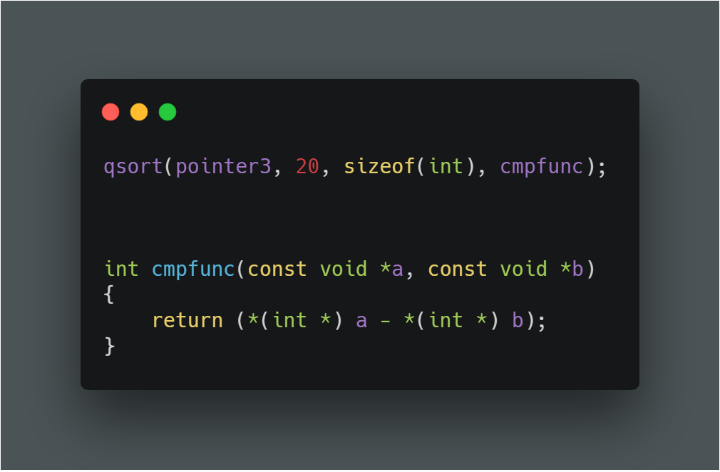
QSORT() FUNCTION

Slide 6
QSORT() FUNCTION

Slide 7
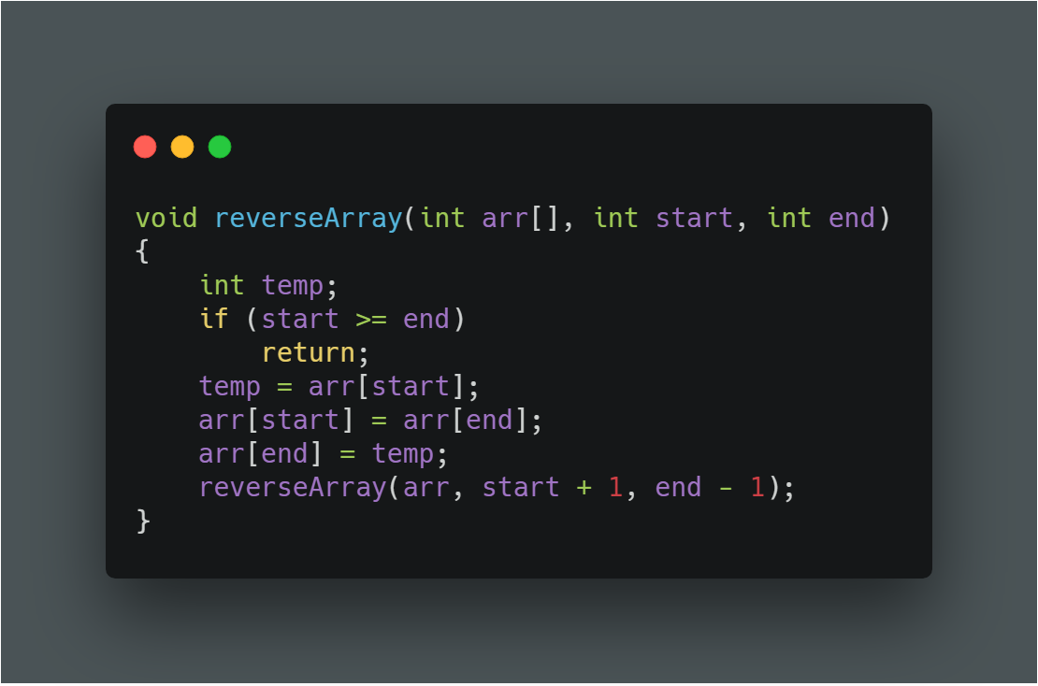
REVERSE ARRAY

